Slide 1
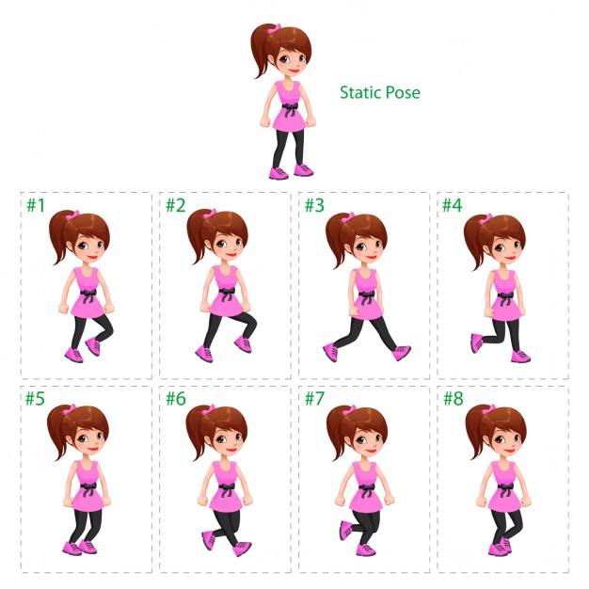
Notes:
Buy Me A Coffee: rajivkohli1977@okicici
Support Us @ https://www.patreon.com/theteacher
Learn More @ www.theteacherpoint.com
Watch Our Tutorial Videos @ www.youtube.com/TheTeacher
PayPal: rajivkohli@msn.com

